Slide 1
“Naturally SMART”
Exploring WCS SMART Connect the way you think and speak

Slide 2
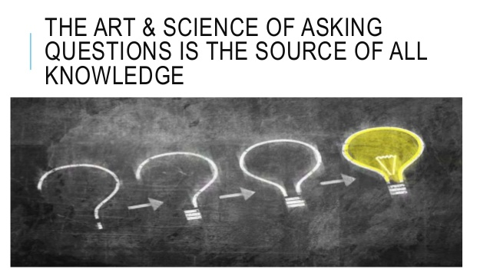
The right questions lead to meaningful answers…

Slide 3
The right questions lead to meaningful answers…
“The scientist is not a person who gives the right answers, he’s one who asks the right questions.”
Claude Lévi-Strauss

Slide 4
The ability to perform natural language queries opens SMART Connect to exploration like never before…
Quicker results (more users, more questions, more results…)
Better accessibility
No need to learn “query language”
Data visualization through free language association

Slide 5
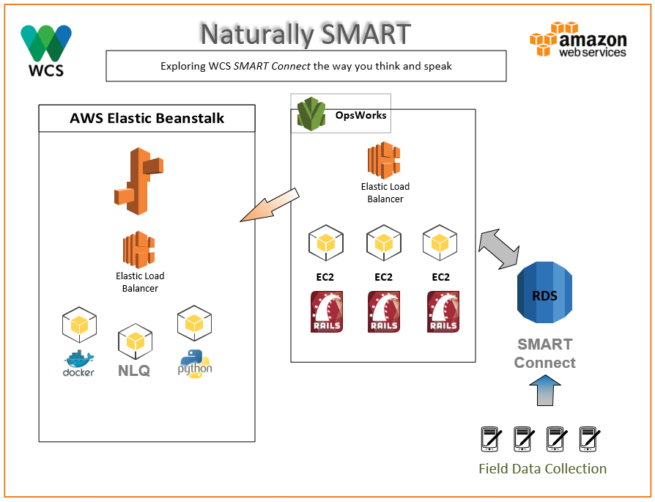

Slide 6
Demo…

